Slide 1
RNA-DNA differences identification
ATGCTTGAC
ATGCATGAC
Giovanni Quinones Valdez
Lab meeting: 10/04/2018

Slide 2
Motivation
To create a pipeline to identify RNA-DNA differences (mismatches) that can be used by all lab members.
To modify the current scripts to accept bam files as input, as they are the main output format from aligners.
Include reads with Soft Clipping and InDels (2.5 – 3% of the reads).
To improve run time and memory usage.
To merge information from multiple chromosomes to improve the log likelihood ratio estimation (more power).

Slide 3
Methods
Step1
Identify the coordinates of mismatches
Pool mismatches from multiple samples
Step2
Identify the reads overlapping the mismatch coordinates
Filter reads
Step3
Calculate editing ratio
Calculate Log Likelihood Ratio (LLR)
LLR = 3.4
LLR = 0.7

Slide 4
Methods
Step1
Identify the coordinates of mismatches.
Approach:
Compare the Ref sequence to Read Sequence base by base.
Pool mismatches from multiple samples.
One chromosome at the time for all samples
Filters:
Position from ends (> 5 nt)
Read Quality (Phred = 33, > 20)
Non secondary, proper-paired
Minimum Read coverage per editing type per locus.
Sample | chr1 | chr2 | chr3
SM1
SM2
SM3

Slide 5
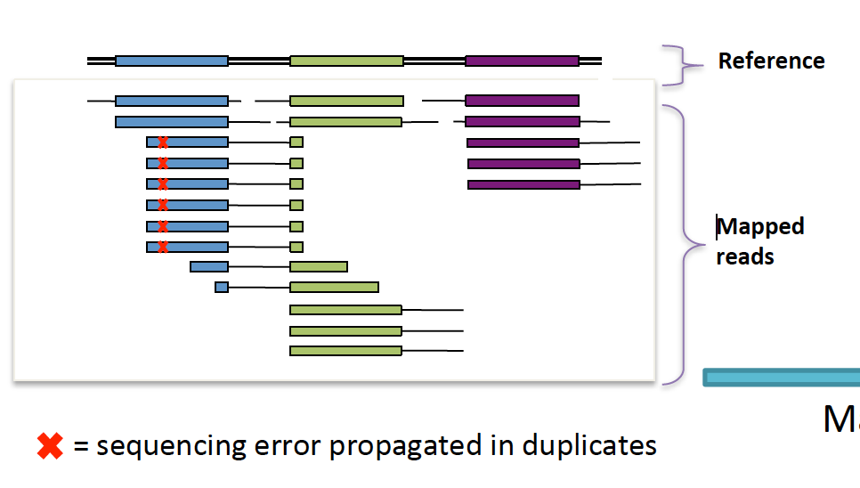
Methods
Step2
Identify the reads overlapping the mismatch coordinates.
Dynamic sub setting of mismatch list according to read coordinates. Aided by binary search of closest MM
Faster then pileup approach (more common)
Filter reads (same as before)
Additionally, we filter for PCR duplicates. We select unique start and end coordinates for every pair of reads.
Reads (sorted)
Mismatches
GATK: Marking PCR Duplicates

Slide 6

Methods
Step2
LLR calculation.
This step counts the number reads that for each condition (reference base, quality, read position) where the mismatch happens.
Per chromosome per sample.
Memory.
PCR removal is on the spot, so no need for intermediate files for this step.
Saving intermediate information in binary pickle files and binary arrays.
MM coordinates files: 4.7x compression
MM read information files: > 4x compression
$$Count\left\{ref=G\right\}\left\{Pos_{read}=50\right\}\left\{q=20\right\}\left\{b=C\right\}=n$$
Sample | chr1 | chr2 | chr3
SM1
SM2
SM3

Slide 7
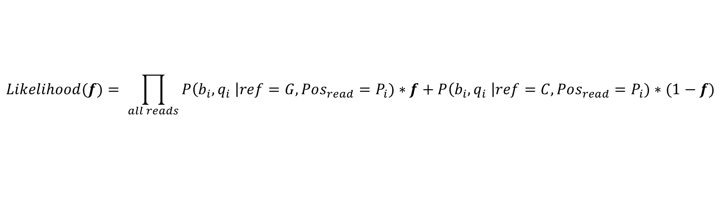
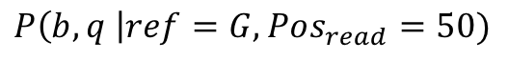
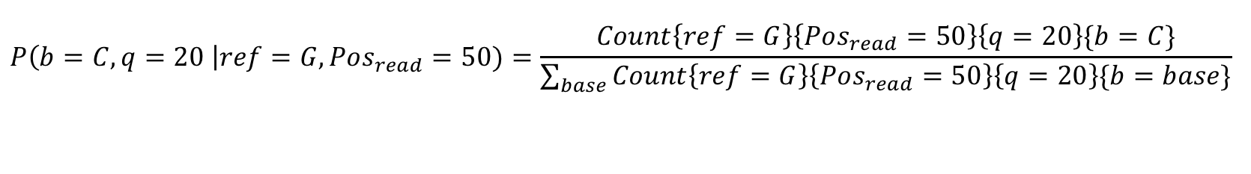
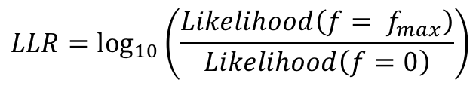
Methods
Step3
LLR calculation.
B = Nucleotide in read ; q = quality of the nucleotide in read.
It calculates the most likely editing ratio and its confidence based on the quality of the reads containing the mismatch.
LLR = 3.4
LLR = 0.7
$$P\left(b, q \right|ref=G, Pos_{read}=50)$$
$$P\left(b=C, q=20 \right|ref=G, Pos_{read}=50)=\frac{Count\left\{ref=G\right\}\left\{Pos_{read}=50\right\}\left\{q=20\right\}\{b=C\}}{\sum_{base}{Count\left\{ref=G\right\}\left\{Pos_{read}=50\right\}\left\{q=20\right\}\{b=base\}}}$$
$$Likelihood(f)= \prod_{all reads}{P\left(b_{i}, q_{i} \right|ref=G, Pos_{read}=P_{i})∗f+P\left(b_{i}, q_{i} \right|ref=C, Pos_{read}=P_{i})∗(1−f)}$$
$$LLR=\log_{10}\left(\frac{Likelihood\left(f= f_{max}\right)}{Likelihood\left(f=0\right)}\right)$$
By Dr. Grace Xiao

Slide 8
Methods
Step3
Calculate Log Likelihood ratio (run time reduction)
Newton’s method: Instead of trying multiple values of f to try f_{max} (1000 iterations) we use Newton’s approach to find the zeros of the derivative (~3 iterations).
Avoid redundant information: Multiple reads have the same probability value (same mismatch type, same quality bin, same read position bin). No need to repeat the operation multiple times.
The calculation is done with reads obtained form all chromosomes
Sample | chr1 | chr2 | chr3
SM1
SM2
SM3

Slide 9
Results: comparison of editing ratios and LLR
Increasing accuracy with increasing read coverage cutoff
(Tracey’s) Nicotine dataset (editing ratio vs LLR)

Slide 10
Conclusion
The new pipeline is separated into 3 main steps to minimize the running time and allow the user to select the number of jobs to merge together.
Lowered I/O load to the cluster with lower memory requirement.
Greater power for LLR calculation.
Overall, very reproducible editing ratio and LLR values.
Low overlap of sites identified, greatly increased however by considering higher coverage thresholds.
7-filters script is also modified to run faster and not need intermediate files.
All sites after 7-filters
All sites after 7-filters (XX > 2 edited reads)

